Slide 1


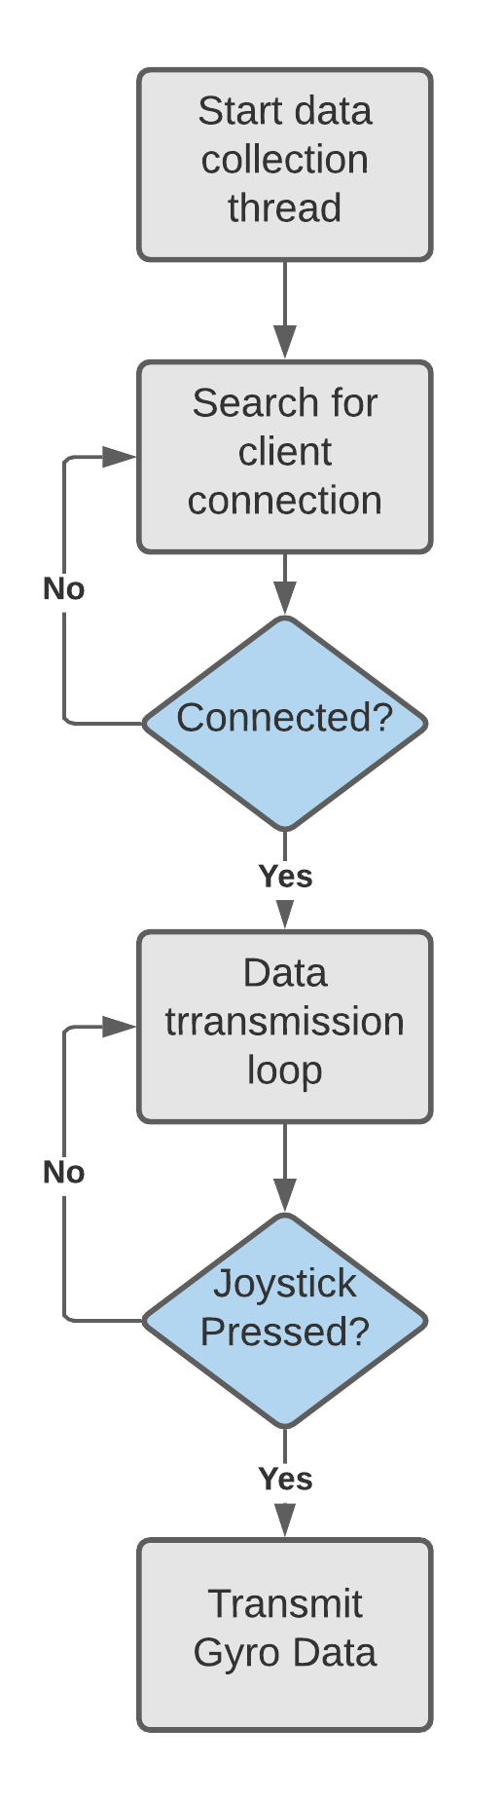
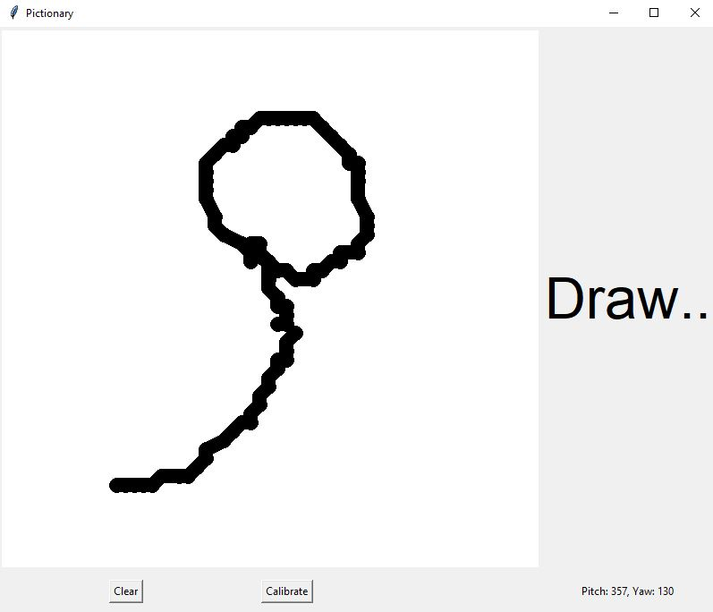
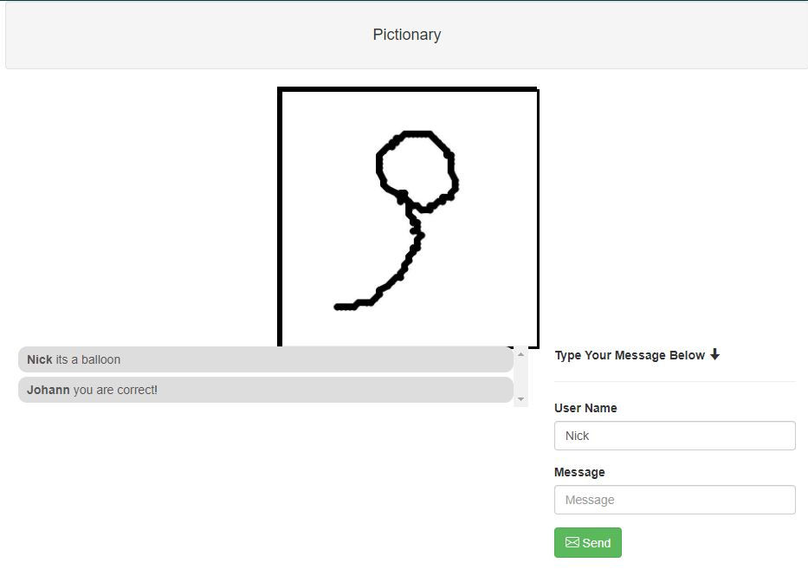
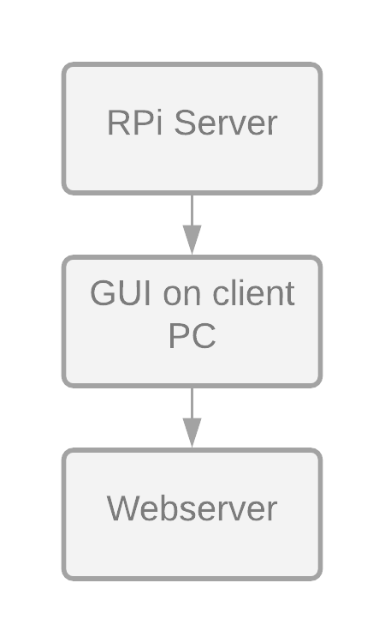
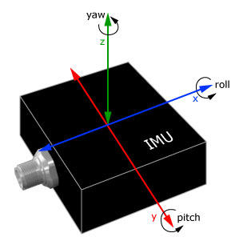
Sensehat Pictionary Game
Nicholas Clavette, Johann Karl Muller
Department of Electrical, Computer, and Biomedical Engineering, University of Rhode Island, Kingston, RI
Project Description
Raspberry Pi Server
GUI and Web Server
Pictionary is a game where teams alternate turns guessing what a drawer is drawing
This version of Pictionary uses a Raspberry Pi with a SenseHat to control the drawing
The SenseHat provides an IMU to send gyroscope data
The player can connect and calibrate their Raspberry Pi to their computer by following the steps in the GUI.
When data is transmitted from the Raspberry Pi, the GUI will convert the pitch and yaw degrees into a printable x and y coordinate, and draw it on the screen
When the server is started a thread is initialized, which samples the gyroscope as quickly as possible
The server then looks for a client connection, and if found, enters the data transmission loop
In the data transmission loop, if the joystick is pressed down, the server encodes the current gyro reading from the thread and sends it to the client
25.1.223.207
Project Motivation
Helps increase social interactions
Provide a new fun way to play Pictionary
High Level System Overview
The GUI updates an image file which is displayed on a web server
Players on the server can guess what the drawer is drawing
Below is a high level block diagram of the system and its components, describing how the project was achieved.
A server is hosted on the players Raspberry Pi to transmit gyroscope data
A GUI application on the players PC connects to the Raspberry Pi server to receive gyroscope data
A Web-server is hosted, where the drawings displayed on the GUI are displayed to other players
The maximum delay recorded is the transmission delay itself.
Each transmission is a Python dictionary with the pitch and yaw data
Conclusions
To maximize performance, we needed to minimize the number of transmissions needed to receive necessary data. We only transmitted Python dictionaries with the IMU data.
Machine learning was unable to be implemented due to time constraints and bugs with calibrating the IMU motion to coordinates to draw on a canvas
In the future, machine learning could be implemented to detect shapes such as rectangles, triangles, and circles, as well as to smooth lines.

